Slide 1
Data Storytelling & Statistical Validation
Sales Data Analysis Project
Presented By:
Name : M. V. Kavyanjali
Internship: Data Analytics Internship

Slide 2
Tasks
Task-1: Data Immersion & Wrangling
Task -2: Exploratory Data Analysis(EDA)& Business Intelligence
Task-3: Deep-Dive Analysis & Interactive Dashboarding
Tools Used
Microsoft Excel / Google Sheets
Power BI
GitHub
Microsoft PowerPoint

Slide 3
Project overview
This project focuses on analyzing sales data to extract meaningful business insights using data analytics techniques. The project involved cleaning and preparing the dataset, performing exploratory data analysis (EDA), creating an interactive dashboard, and presenting the findings through data storytelling and statistical validation. The insights help identify sales trends, top-performing product categories, customer purchasing patterns, and support data-driven business decisions.

Slide 4
Project Objective and Goals
Objective
The objective of this project is to analyze the sales dataset and identify meaningful business insights that support better decision-making. The analysis focuses on sales performance, customer purchasing behavior, product categories, monthly sales trends, and regional performance.
Golas
1.Analyze sales performance.
2.Identify top-selling product categories.
3.Find the best-performing cities.
4.Understand monthly sales trends.
5.Provide business recommendations.

Slide 5
Task 1: Data Immersion & Wrangling
1.Improve dataset
2.remove duplicates
3.Handling missing values
4.Prepared clean dataset
Task-2:EDA &Business Intelligence
1.Explored sales trends
2.Analyzed categories
3.Compare customer behavior
4.create visualizations
Task-3:Interactive Dashboard
1.Totals sales 139.24 million
2.grocery category highest sales
3.Male & Female sales nearly equal
4.Sensonal monthly trends

Slide 6
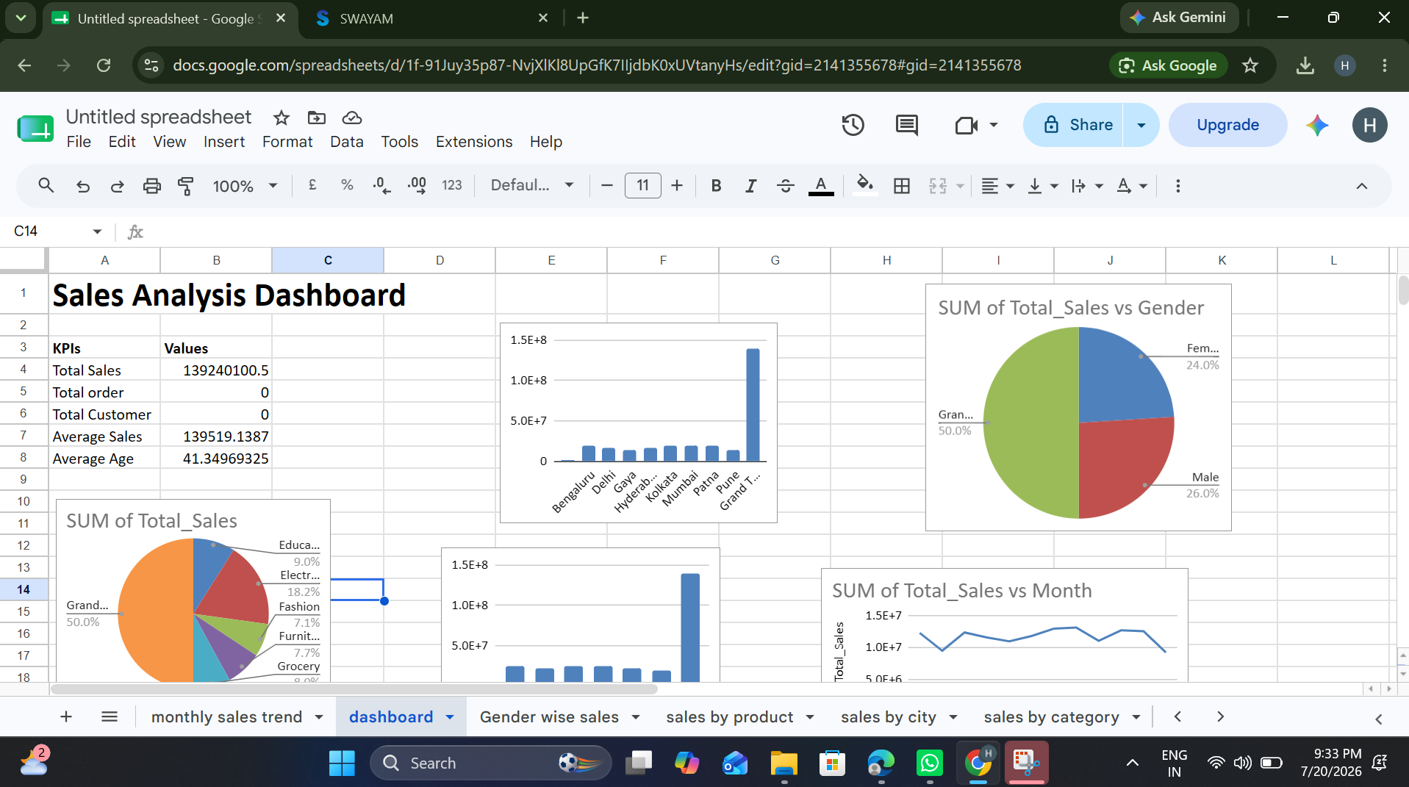
Dashboarding

Slide 7
Key Insights
Total Sales: ₹139.24 Million.
Grocery is the highest-selling product category.
Male and female customers contribute almost equally to total sales.
Monthly sales show seasonal fluctuations.
The dashboard helps identify top-performing categories and supports better business decisions.

Slide 8
Business Recommendations
Increase inventory for high-demand products.
Launch promotional campaigns during peak sales months.
Focus marketing efforts on high-performing cities.
Provide loyalty rewards for repeat customers.
Improve the online shopping experience.
Monitor low-performing categories and introduce discounts.

Slide 9
Hypothesis Testing & Statistical Validation
Hypothesis
Null Hypothesis (H₀): There is no significant difference in sales between product categories.
Alternative Hypothesis (H₁): There is a significant difference in sales between product categories.
Statistical Validation
Compared sales across categories.
Observed Electronics had the highest average sales.
The analysis supports the alternative hypothesis.

Slide 10
Skills Gained
Data Cleaning
EDA
Dashboarding
Data visualization
Business Analysis
Power BI

Slide 11
Conclusion
This project successfully analyzed the sales dataset and transformed raw data into meaningful business insights.
The dashboard highlights important sales trends, customer behavior, and business opportunities.
The recommendations provided can help improve marketing strategies, inventory management, and overall business performance.

Slide 12
THANK YOU

